Slide 1
Valuation: Stated preferences
Introduction
Contingent Valuation
Introduction
Case study
Controversies
Choice Modelling
Introduction
Case study

Slide 2
0 Introduction
1 Social choice
2 Externalities and public goods
3 Decision analysis
4 Valuation: Aims and purpose
5 Valuation: Revealed preferences
6 Valuation: Stated preferences
7 Direct regulation
8 Market-based instruments
9 Imperfect information
10 Growth and the environment
11 Green accounting

Slide 3
Stated Preference (SP) methods
Infer preferences for environmental goods from reports of intended behaviour in hypothetical markets for those goods
Notes:
OK — so that was the theory of how we value stuff.
How do we operationalise this? Do it in practice?
Today, we’re looking at SP.
…
Pretty simple. Simpler than this sounds!
Could also say
Infer preferences for environmental goods
by asking people what they’d pay for them

Slide 4
Two flavours
Contingent Valuation (CV)
Based on direct question(s) concerning WTP/WTA for an environmental good
Choice Modelling / Choice Experiments (CE)
Based on choices between hypothetical goods with varying attributes, including environmental attributes and price
Also popular in transport, and in market research (‘conjoint analysis’)
What would you pay for this good?
Would you pay £X for good A, £Y for good B, or neither?
Notes:
We’ll look at these both in a bit more detail
CV - like the question I asked about preventing the Deepwater Horizon disaster in our first lecture together.

Slide 5
SP: many strengths
Total Economic Value
Including use, option and non-use values
Not reliant on any actual market
… nor on such markets being perfect
… nor on the availability of data on such markets
Hence applicable ex-ante — including to novel goods, or novel levels of goods
Can explore reasons behind preferences
Widely used and researched
Comprehensible to policymakers!
Notes:
Explore reasons e.g. Why are people WTP for cleaner air? Cleaning bills? Aesthetics? Health?
Great strengths.

Slide 6
SP: real weaknesses
Costly, time-consuming
Not rooted in actual behaviour
Money not where the mouth is
Various potential biases …
Notes:
Requires complex, large scale surveys, much piloting and refinement, etc.
Not actual behaviour — next slide
Biases — later on this lecture

Slide 7



3 leaps from real behaviour: assumes …
actual behaviour in a real market = intended behaviour in a real market = intended behaviour in a hypothetical market = reports of intended behaviour in a hypothetical market
Notes:
SP sometimes controversial, because all 3 of these equalities are open to question…
intention not always action (e.g. me driving to work)
hypothetical market may not be fully described, fully understood, certainly not experienced — I may not be able to fully predict how I’d behave
reports may differ from actual intentions — social desirability bias
…
So there are serious weaknesses. But also serious strengths — ability to get at non-use values especially.

Slide 8
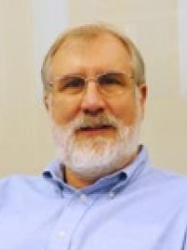
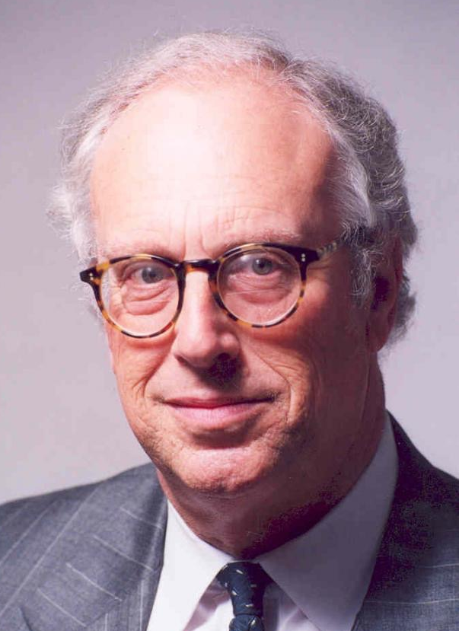
Big stuff
“It is hard to overestimate the central importance of contingent valuation to modern environmental economics” — Carson & Hanemann, 2005
Notes:
Thousands of papers

Slide 9
Contingent Valuation
Notes:
Look first at CV.

Slide 10
What would you pay for this good?
Notes:
CV, as I said earlier, is based on answers to questions like this.
Sounds straightforward.
Unfortunately implementation is not as straightforward as it sounds ->

Slide 11

CV: step-by-step
Background research
Survey mode, population & sampling strategy
Survey design (…)
Pre-test: focus groups & cognitive interviews
Re-design
Hire and train interviewers
Field pilot
Re-design
Main survey implementation
Data entry and quality control
Econometric analysis
Validity, reliability testing
Aggregation
Report writing, presentation of results
Evaluation
Notes:
(super brief here)

Slide 12
CV survey content
Use of good
Opinion, satisfaction
Attitudes
General topic
Specific good
Scenario
Current situation
Proposed situation
Elicitation of values
Payment vehicle
Elicitation mechanism
Follow-ups
Motivation, protests
Credibility
Demographics
Age, gender, income, education, family size, …
Notes:
What goes into a CV survey? (lots, but won’t dwell)

Slide 13



Scenario
Clarifies status quo and describes proposed change
Text, figures, photos, maps, video, …
Credible
e.g. Exxon Valdez: double-hulled tankers + escort and emergency-response ships
Meaningful to respondent
Not: “52 MPN faecal coliforms per 100mL”, but:
X
✔
✔
Notes:
How much detail?
People need to know a lot to make an informed judgment.
But people have very short attention spans.

Slide 14
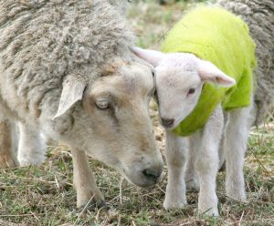
Neutrality & framing
Fluffy little baa-lambs will be senselessly slaughtered
aka minor livestock losses
Notes:
Need to be neutral or objective in your scenario descriptions.
But what’s neutral? Here are 2 ways to describe the same impact. Neither is neutral?

Slide 15
Payment vehicle
Taxes
Bill surcharges
One-off or recurring?
Not voluntary
For a public good
Notes:
Payment vehicle = the mechanism of payment.
Various possible.
…
WTP can vary by vehicle. Uh-oh.
Note no compensation vehicles here. WTA is almost never assessed.

Slide 16

Some elicitation methods
Open-ended
So: how much are you WTP?
Payment ladder, payment card
Tick the amounts you are certain you are WTP, and cross those you are certain you aren’t
Dichotomous choice (DC), referendum
The policy will cost £X per household. Will you vote for it?
Trichotomous choice
If not, how about £X-Y?
If so, how about £X+Y?
Difficult, unfamiliar, high non-response rates
Easy, incentive-compatible, but inefficient
Notes:
…
Strengths & weaknesses.
Method of analysis depends on elicitation method, as we’ll see later.
WTP may also depend on method. Uh-oh!

Slide 17
Analysis: varies by elicitation type
Open-ended
Mean and median WTP = mean and median WTP
Payment ladder
Midpoint of highest ‘yes’ and lowest ‘no‘ — see above
Interval regression
Dichotomous choice
Random Utility Model: logit or probit

Slide 18
RUM for DC (= basic logit)
If yes:
uYES ≥ uNO
vYES + εYES ≥ vNO + εNO
For income y, bid amount p, env. good x
β0(y – p) + β1x + εYES ≥ β0y + εNO
Assuming ε ~ Gumbel:
Pr(yes) = exp(β1 – β0p) / [1 + exp(β1 – β0p)]
Estimate βs with maximum likelihood
WTP = – β1 / β0
Notes:
Very like what we’ll see for TC next week …

Slide 19
Controversies

Slide 20
How robust are CV results?
Face validity – does what it intends to do
Criterion validity – best practice
Construct validity
Convergent validity – related measures correlate
Divergent validity – unrelated measures do not
Compatibility with theory
Test-retest reliability
Notes:
Face validity = look at study design and exercise common sense. Correct, credible scenario; not too many protests or non-responses; representative; sensitivity to outliers; etc.
Criterion = compared to some gold standard, such as actual market prices. Generally not available, which is why we’re doing CV.
Convergent = other valuation method (RP, SWB). CV results on average lower than RP (odd, given TEV + other concerns).
Theory: e.g. price coeff negative, WTP falls with distance, increases with income and qty of good, etc.
Test-retest reliability: few studies check, generally OK, but not always.

Slide 21
Hypothetical (non-commitment) bias
Most persistent criticism of CV
No real economic commitment (no skin in the game)
‘Ask hypothetical question, get a hypothetical answer’
Notes:
Not going to have to pay, so don’t think same way: no budget constraint, and no substitute considerations.

Slide 22
Possible solutions
Give respondents time to think
CV interview split in two: one day the respondent is shown the scenario and valuation question; another day he is asked for his response
Time to discuss value with household members, consider budget constraint and substitutes, avoid yea-saying
Drop-off protocol
Interviewer drops off survey and picks it up at a later stage
Recalibrate SP results with data from real experiments
‘Cheap talk’ scripts …
Notes:
Also: compare with other valuation techniques
Cheap talk: imagine this were a real situation and think hard about your budget; don’t just say you’d pay to make you feel good about yourself.

Slide 23
Cheap talk
“Studies have shown that people answering surveys such as this often say that they are willing to pay more than they would if the situation was real and this amount of money actually had to be handed over.
What our ‘yes’ vote really means is that we are basically good people, and that we would like to see good things happen!
But when the situation is real, and we would actually have to spend our money, we think in a different way. We basically still would like to see good things happen, but when we are faced with the possibility of having to spend money, we think about our options: If I spend money on this, that’s money I don’t have to spend on other things.
So while answering this next question please think as if the situation we described were real and you would actually have to pay the amount of money stated.”

Slide 24
Other biases & anomalies
Protests
WTP/WTA disparity
Strategic bias
Use dichotomous choice
Part-whole bias, embedding, scope insensitivity
Due to ‘warm glow’?
Temporal embedding
Sequence effects, ‘adding-up’ problem
Starting-point bias, anchoring
Interviewer bias
Yea-saying, nay-saying
Prominence bias
Information bias
Non-response bias
Notes:
[1 slide, but important!]
Protests: identify & exclude (if not too numerous). E.g. don’t believe scenario. E.g. Nature not for sale.
WTP/WTA disparity — mentioned earlier.
Strategic bias: stated WTP to be used to set own tax liability! DC theoretically immune. Not clear that respondents know this, though!
Part-whole: e.g save a species vs save all species. 100ha vs 500ha of wetland. Temporal: annual WTP = one-off.
Information: e.g. don’t know enough about ecosystem functions. e.g. WTP to save 1T carbon!
(Paul Dolan at Treasury: tell me what value you have in mind and I’ll do you a stated preference study to come up with it.)

Slide 25
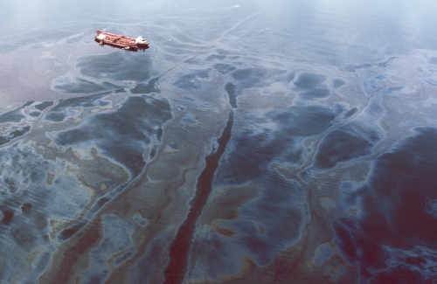
Exxon Valdez Prince William Sound, Alaska, 1989
Notes:
I mentioned the Exxon Valdez spill (just now?, and) in our first lecture.
This was a big moment for CV.
US had in the previous few years enacted laws that allowed for recovery of monetary damages for injury to the environment.
State of Alaska’s claim for damages against Exxon was based largely on the CV study they’d commissioned. Study by Carson et al — which we’ll read more about for the seminars on Thursday.
Oil industry launched a PR campaign to discredit CV, and did a huge amount of political lobbying too.
In response, the US NOAA (US Nat’l Oceanic & Atmospheric Administration) set up a ‘blue-ribbon’ commission headed by 2 Nobel-prizewinning economists to investigate CV.

Slide 26

NOAA Blue Ribbon report
Personal interviews
Probability sampling
Ask for WTP, not WTA
Dichotomous choice WTP questions
Accurate description of program or policy
Careful pre-testing
Reminders of substitutes, budget constraint
Follow-up questions for credibility
…
Gold standard for “best practice” CV?
But made CV very expensive — and WTP requirement is dubious
Focus on US litigation
UK Gov't published own guidelines on best practice in 2002
Focus on current UK practice and use in CBA
Notes:
Concluded that CV is a legitimate and useful tool.
But should be conducted conservatively, burden of proof very much with researchers at every stage.
Key recommendations included …
…
Too expensive, except for large projects — focus on US litigation around big environmental disasters. High stakes! And damages that can be completely justified — so OK to err on the low side.

Slide 27
Controversies: general remarks
Scepticism important in application, use, interpretation of CV
Careful survey design can overcome many issues — but not simple, and may be expensive
CV remains an essential tool for environmental economists, particularly where non-use values are important

Slide 28
The worst valuation methodology …
apart from all the others?
Notes:
In a nutshell, and to paraphrase Churchill, …

Slide 29
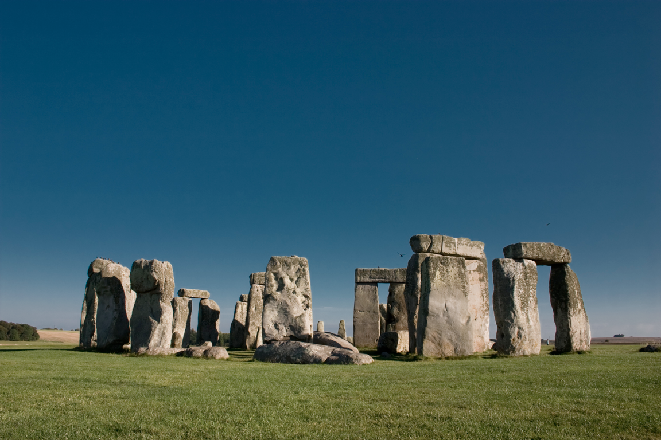
Case study 1: Stonehenge roads
Notes:
[BREAK?]
Stonehenge is one of the best known and archaeologically most important monuments in the world. It was constructed between 5,000 and 3,500 years ago..

Slide 30
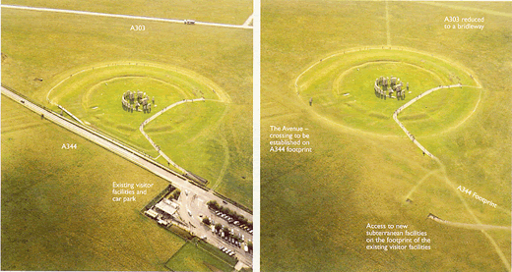
Notes:
Current road layout
Two busy roads near the site — one actually cutting through it.
View of road and roar of traffic are rubbish if you want to enjoy the site. Also rubbish if you’re a druid.
But the view of the monument is nice if you happen to be driving past.
Proposal:
2km tunnel for A303 (busy road to South)
Closure + dismantling of A344 (road to North)

Slide 31
Stonehenge proposal
Costs
£125m construction and maintenance
Loss of visual amenity for drivers
Benefits
Time savings
Lower vehicle operating costs
Fewer accidents
Gain in visual amenity for visitors
Noise reduction
Reunification of the landscape
Notes:
Not clear if this proposal will result in a net gain or a net loss of welfare: hence CBA.
White costs and benefits are the usual factors considered by DfT in a transport project appraisal.
But ignore the main reasons for undertaking the project! I.e. the yellow highlighted costs and benefits, which are the environmental or heritage factors.
English Heritage commissioned an SP study to value these in 1998.

Slide 32
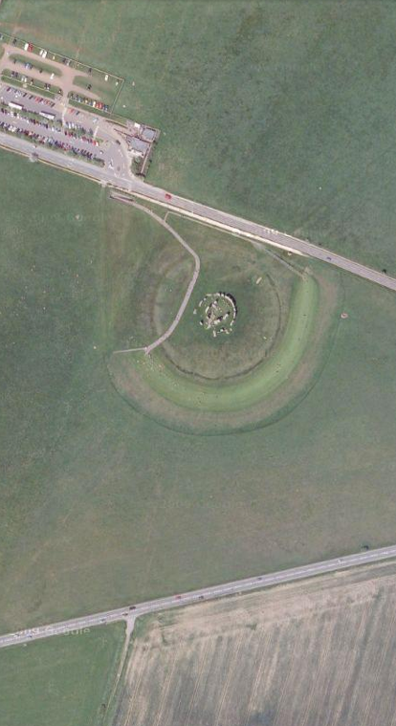
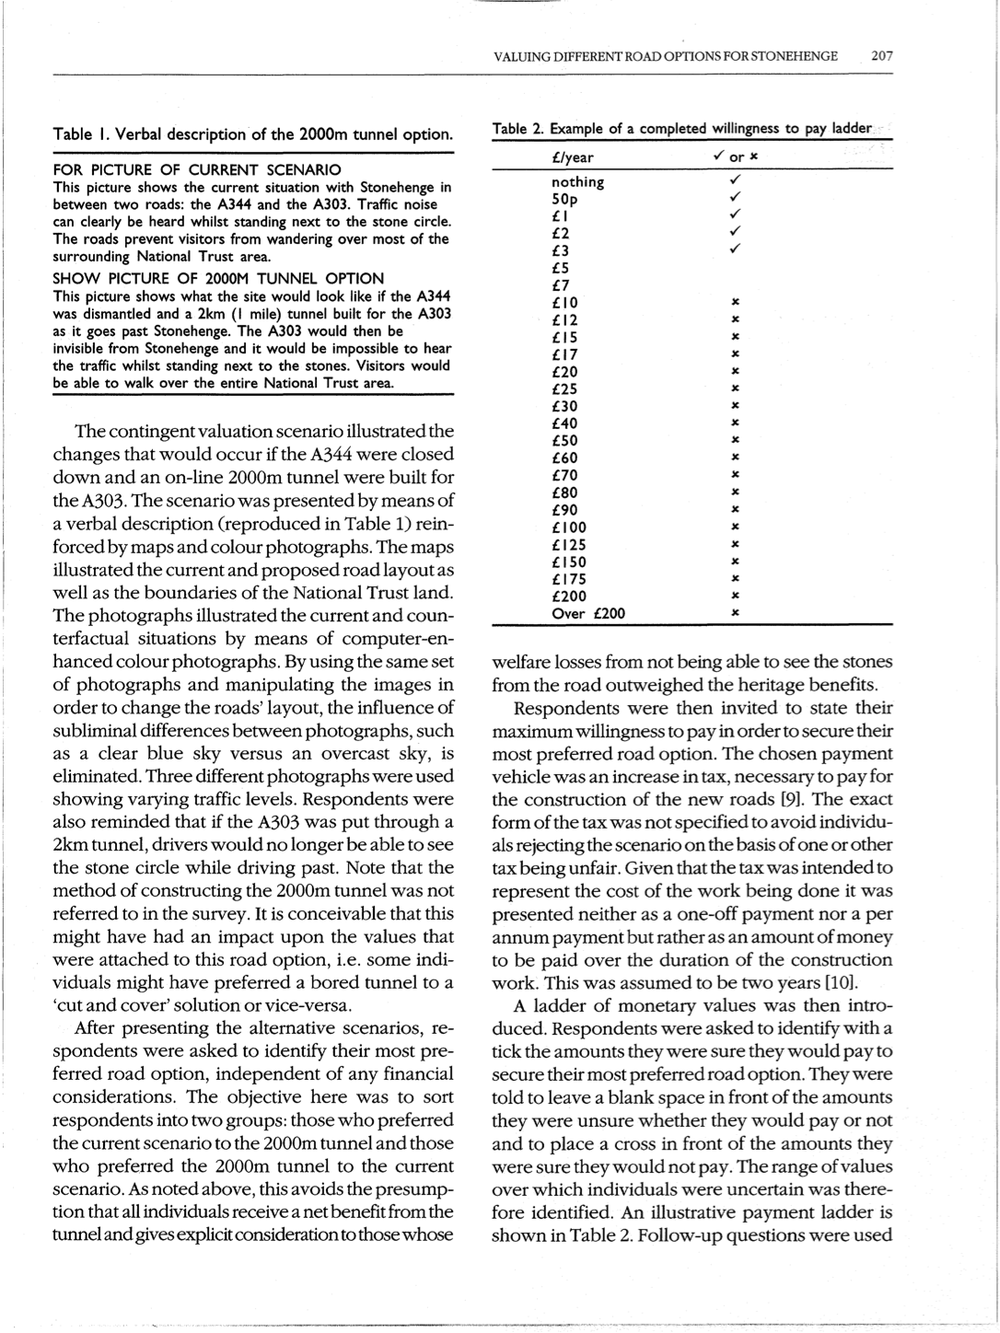
Scenario
Verbal description, maps, images (Photoshopped)

Slide 33
Value elicitation
Which option preferred?
Status quo or proposed change
Max WTP to secure?
Implies no right to either situation
Vehicle: non-specific tax over 2 years
Format: payment ladder
Notes:
Tick all the amounts you’re sure you would pay
X all the amounts you’re sure you wouldn’t
Note: people told to consider only the benefits described: not any safety or journey time benefits — otherwise those would be double counted.

Slide 34
Follow-up questions
My household cannot afford to pay
I like the current situation
I think this problem is not a priority
The government should pay for this
Taxes are high enough as it is
Notes:
Which are protests? (last 2)

Slide 35
Preferences and WTP (re-weighted)
55% prefer status quo
Mean WTP: £2.69/year
Dropped protests about paying for nothing to be done
Main motivations: miss view from road, and dislike driving in tunnels
45% prefer tunnel
Mean WTP: £8.90/year
Main motivation: secure landmark for future generations
£££
£££££££££
Notes:
Outcome?
Weighted to approximate whole of UK
Yearly values, over two years of construction only
Two ways to see this!
1. valuation allows us to assess strength of preference and come to a better decision than a simple poll does
2. valuation is profoundly anti-democratic, and lets a wealthy minority dictate policy for the rest of us

Slide 36
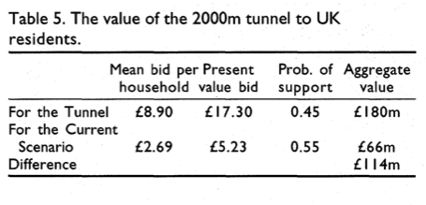
Aggregation
Notes:
col 2: present value over 2 years at 6% discount rate (??)
Pushes CBA to net benefit: worth doing. Govt announced would be built.
But still not done. Disputes over bored vs cut-and-cover tunnel. Plans abandoned.

Slide 37
Choice Modelling

Slide 38
Discrete alternatives
Assume value of a good is a function of characteristics
Ask for choices between alternative options
Options vary in characteristics — including price
Choices involve trade-offs
WTP is inferred from choices made
Notes:
1 -- like hedonic pricing studies

Slide 39
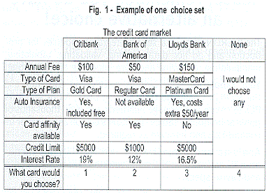
Notes:
This is a market research CE.
Mimics the sort of market situation that’s supposed to make us familiar with CEs.

Slide 40
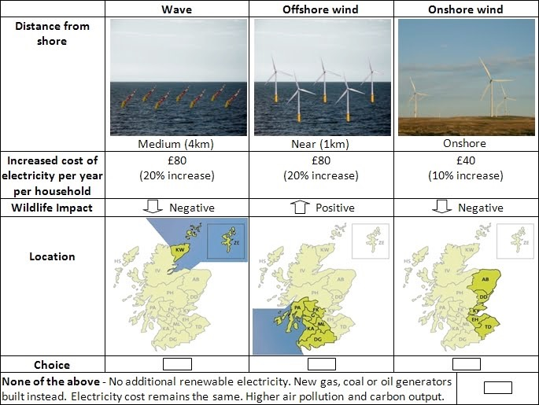
Notes:
Environmental example, 4 options. Which would you choose? 30s to decide.
…
Wave (hands up) … etc …

Slide 41
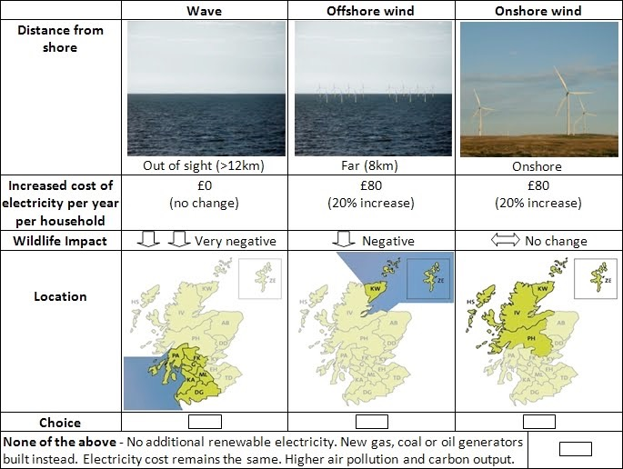
Notes:
Attributes vary between cards. In this study, 6 cards per respondent.

Slide 42
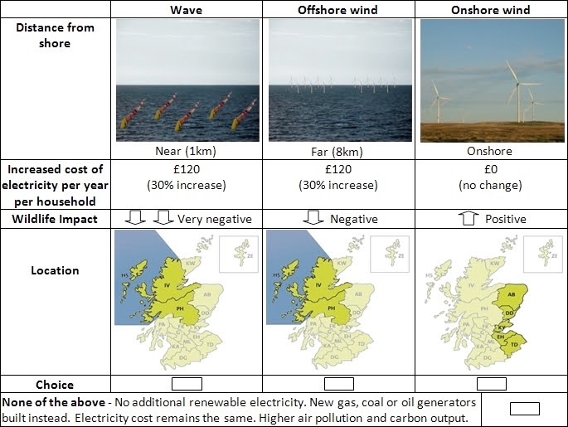
Attributes
Options or alternatives
Labels
Price attribute
Levels
Status-quo option
electricitysurvey.com
Notes:
Terminology
Each choice set is presented on a choice card.
On each card, you have several options which vary in the levels of attributes
For compatibility with welfare theory, a status quo option must be available: nothing done, no cost.
Some attributes may have a prior expectation on whether +ve/-ve (e.g. price, wildlife). Others may not (e.g. location).
From a study carried out by a PhD student at Stirling.

Slide 44
Choice modelling: better than CV?
WTP for attributes
Multidimensional change
Infer WTP for projects nobody was asked about — by combining attributes post-hoc
Diffuse cost focus
WTP is implicit
Fewer protests
More familiar, more like market choices
Less yea-saying, nay-saying

Slide 45
Choice modelling: worse than CV?
Cognitive burden for respondents
Satisficing, heuristics (e.g. look at one attribute only)
Technical complexity for researchers
Design + analysis
Notes:
one attribute — e.g. ‘the environmentally friendly choice’ or the cheapest
Didn’t I just say it was easier because more familiar?!
If difficult, generally researchers’ fault! Getting greedy and asking about too many attributes and/or presenting too many cards.

Slide 46
Choice experiments: step-by-step
Same as CV, plus:
What attributes?
What levels?
Construct choice sets
Analysis
Random Utility Model — same as for travel cost, last week

Slide 47
Model of discrete choice
Individual i chooses option g out of j = 1, …, J
uig ≥ uij for all j ≠ g
Tastes vary
Decompose u into deterministic and stochastic (random) parts
vig + εig ≥ vij + εij for all j ≠ g
Notes:
Assume a distribution for epsilon

Slide 48
vij — model linearly
m = income
p = price
qn = levels of attributes
vij = β0(mi – pij) + β1q1j + β2q2j
Notes:
In practice there will generally be many q parameters in the model, one per attribute

Slide 49
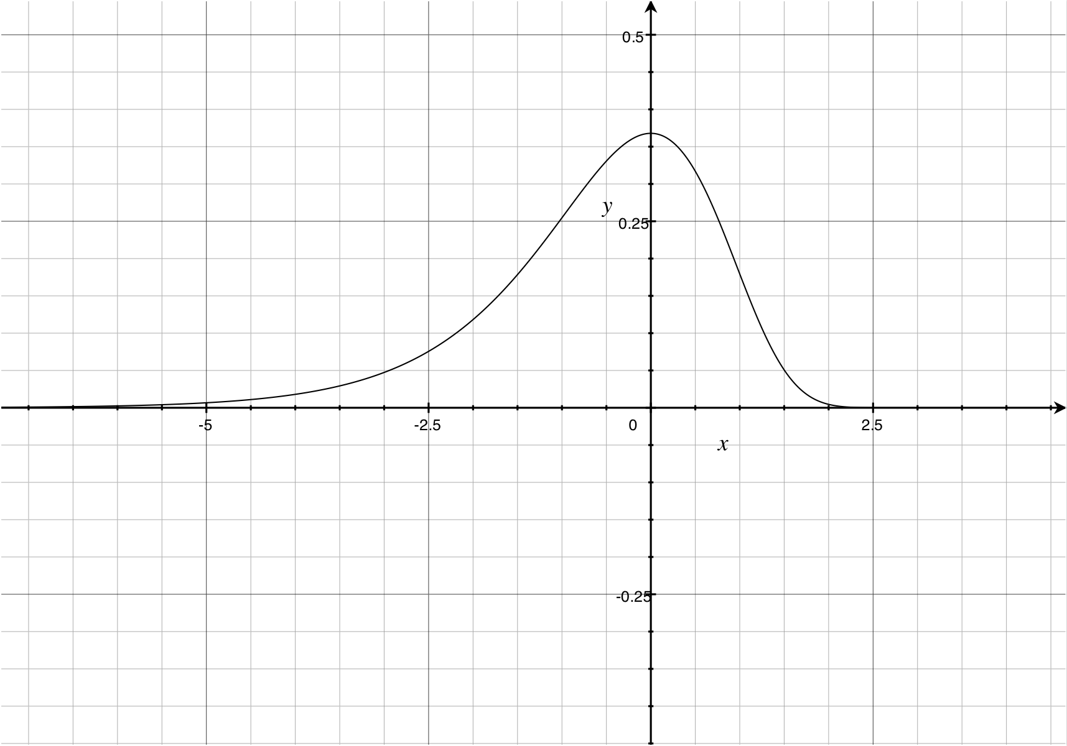
εij — assume Gumbel distribution
Notes:
Specifically, this distribution, the Gumbel or Type I Extreme Value distribution
Why, because it makes the next step super-simple

Slide 50
Estimate with conditional logit
vig + εig ≥ vij + εij for all j ≠ g
Pr(j = g) = exp(vig) / Σ exp(vij)
Multiply Pr(j = g) for all choices
Obtain expression for whole-sample likelihood
Find maximum likelihood
Obtain β parameter estimates
J
j = 1
Notes:
The probability that an individual will choose g out of j sites is …
And since we observe lots of people’s choices we can multiply all these probabilities to give us the whole sample likelihood
Note — as with travel cost, clogit assumes IIA — newer studies use RPL/mixed logit to relax.

Slide 51
Calculate WTP
For marginal change in attribute q1: MWTP = – β1 / β0
For a particular ‘package’: WTP = – (v¹ – v⁰) / β0
Notes:
v0 = status quo

Slide 52

Case study 2:
carbon offsets

Slide 53
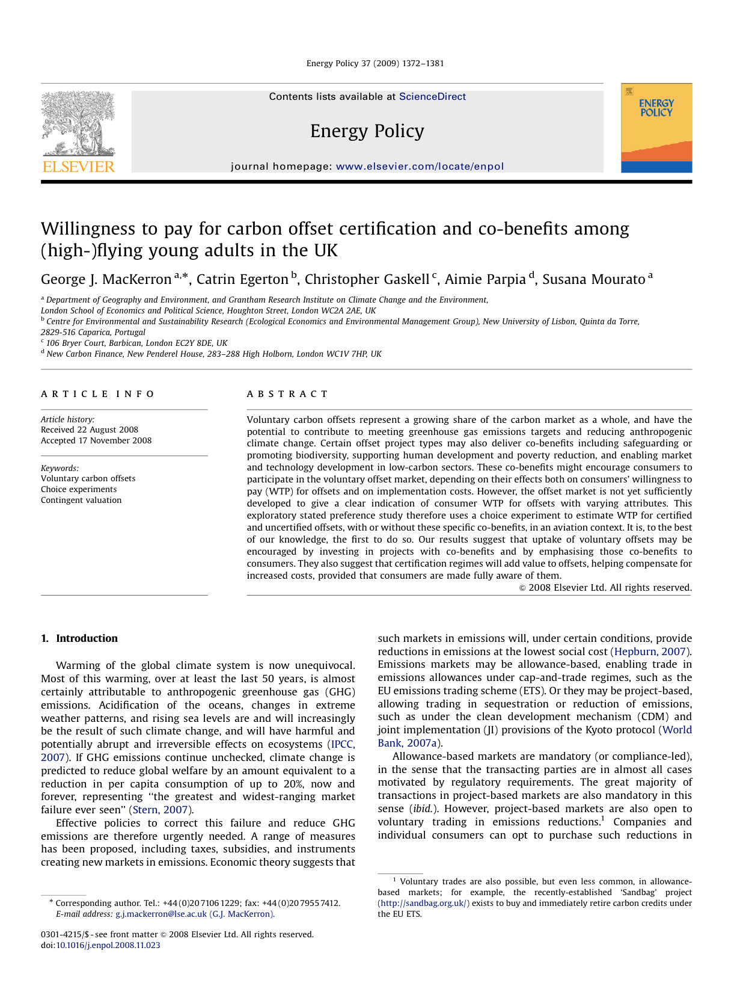
Notes:
A study of mine, plus colleagues, published in Energy Policy.
Not a classic study in env econ — actually more like a market research study. Because although carbon reductions are a public good, offsets are sold in private transactions to consumers.
Looking at impacts of co-benefits and certification on consumers’ WTP for carbon offsets when flying.
Actually in two parts…

Slide 54
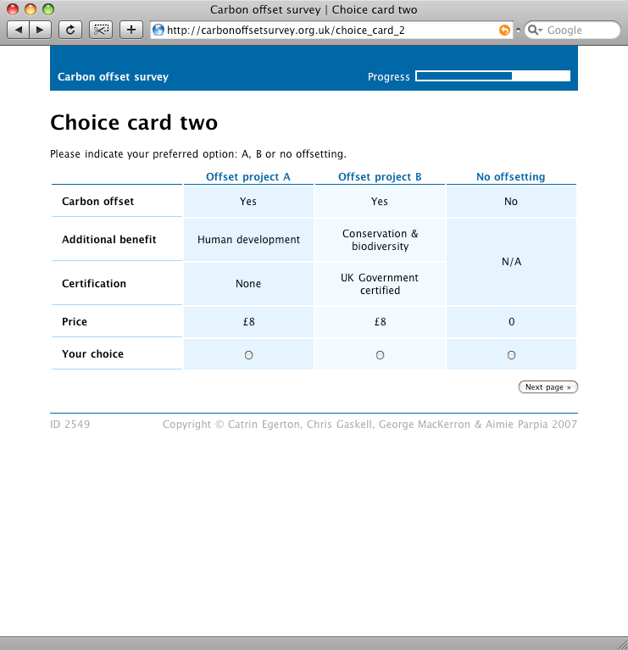
Choice experiment
Conservation & biodiversity
Human development
Market & technology development
None
Notes:
CE consisted of 6 cards like this one.
To estimate WTP for offsets and co-benefits, and certification.
Levels:
Co-benefits: one of the 3 mentioned earlier, or none — these explained to respondents in more detail
Certification: yes or no
Price: same levels as on last slide, £4 - £20

Slide 55
CE results (RPL)
 | Coefficient (std. err.) | Implicit price (95% CI)
ASC (offset) | 3.106 (0.691) | £12.47 (£7.41 – £17.52)
Std. dev. | 5.976 (0.635)
Certification | 2.776 (0.278) | £11.14 (£9.31 – £12.98)
Std. dev. | 2.553 (0.302)
Price | –0.249 (0.021) | –
Std. dev. | Fixed coefficient
Human development | 3.201 (0.358) | £12.84 (£10.41 – £15.28)
Std. dev. | 2.089 (0.361)
Biodiversity | 3.734 (0.356) | £14.98 (£12.67 – £17.30)
Std. dev. | 1.891 (0.381)
Tech./mkt. development | 2.631 (0.284) | £10.56 (£8.62 – £12.50)
Std. dev. | 2.072 (0.313)
p < 0.1% for all parameters
Notes:
V high std dev on offset WTP …

Slide 56
Heterogeneity in tastes…
“
it's an emergency, we must act!
if I don't do my bit, I can't blame others for not doing theirs when the ice cap melts
WE MUST FIGHT FOR THE PENGUINS!!!
this sounds like a scam
it’s bourgeois and distracting to do the whole offset thing
let's all fly more to do more good, right? You disgust me.
”
Notes:
… which we also saw in the text comments left by over one third of our respondents.
On the one hand…
… and on the other …

Slide 57
Measures of value
Maximum willingness to pay (WTP)
How much I value something I do not have is measured by the most that I will give up in order to gain it
Hicksian equivalent variation
Minimum willingness to accept (WTA)
How much I value something I do have is measured by the least I must gain in order to give it up
Hicksian compensating variation
Notes:
That gives us two key measures of value:
First, …

Slide 58
Expenditure on private goods y
y0
WTP
u0
e0
e1
Quantity of environmental good e
Maximum WTP to secure improvement
Notes:
For example.
Let’s say an individual starts out with an income of y0, and enjoys environmental quality of e0.
This puts her on the indifference curve u0. Any combination of y and e along this line provides her with equal utility.
Now let’s say we want to know the value to her of an improvement in the environmental good up to e1. With more of the environmental good, she needs less of the private goods to maintain the same level of utility u0.
And so her maximum WTP is this distance between the dotted lines. If she can obtain e1 for any less than this amount, then she’ll end up better off than she was before. If the cost of obtaining e1 is more than this amount, then she would choose not to pay, if given the choice.
This is max WTP for improvement.

Slide 59
Expenditure on private goods y
WTA
y0
u1
e0
e1
Quantity of environmental good e
Minimum WTA to tolerate deterioration
Notes:
But what if the environmental change is a deterioration rather than an improvement? Then things are a little different.
Imagine the individual starts at e1, with the same income y0. She’s therefore on a higher indifference curve than before.
Now we want to know what amount of compensation the individual would need in order to accept a deterioration, down to e0. We again trace up and across from the indifference curve, and find this amount as the minimum WTA.

Slide 60
4 welfare measures for environmental change
 | Compensating Variation | Equivalent Variation
Implied property right is in ... | status quo | change
Change is an improvement | WTP to secure change | WTA to forgo change
Change is a deterioration | WTA to tolerate change | WTP to avoid change
Notes:
Now there are in fact four possible measures of welfare for a potential environmental change. Which one is appropriate depends on property rights and on whether the change is an improvement or a deterioration.
The two of them we’ve just seen — WTP for improvement, WTA for deterioration — imply that people have a right to the initial situation, the status quo [reveal], but that there will be a change. These are the compensating surplus measures [reveal]. They tell us the amount that compensates people for a change that does occur, when they had a right to it not occurring.
The other two measures imply that people have a right to the change, but that the change doesn't happen. These are the equivalent surplus measures [reveal]. For a change that does not occur, when people had a right to it occurring, they tell us the amount that’s equivalent to the change occurring.

Slide 61
Expenditure on private goods y
y0
WTP
u0
e0
e1
Quantity of environmental good e
Maximum WTP to avoid deterioration
Notes:
We can show the equivalent surplus measures with essentially the same diagrams as before.
Max WTP to …
This is the same diagram as for WTP to secure an improvement — but instead of paying to move from e0 to e1, we’re paying to avoid moving from e1 to e0.

Slide 62
Expenditure on private goods y
WTA
y0
u1
e0
e1
Quantity of environmental good e
Minimum WTA to forgo improvement
Notes:
Likewise with WTA.
Instead of being compensated for the move from e1 to e0, the individual is being compensated to forgo the move from e0 to e1.

Slide 63
Expenditure on private goods y
WTP ≠ WTA
WTA
y0
WTP
u1
u0
e1
e0
Quantity of environmental good e
Notes:
Here I’ve put all the diagrams together.
What do we notice about WTP and WTA?
WTP and WTA for the same change are not the same.
WTA is somewhat higher than WTP.

Slide 64
WTP ≠ WTA: why the disparity?
Income effect
Substitution effect
Hanemann, 1991
Endowment effect, loss aversion
Behavioural economic explanation
Notes:
1. Income effect. Assume there’s substantial income elasticity of demand for the environmental good — i.e. people will pay a lot more for it as they get richer. Now if you compensate me by the amount I was WTP, I’m richer… and thus WTP more than you just gave me!
Income effect can’t sensibly be very large — and hence until the 1990s it was generally thought that WTP and WTA were more or less interchangeable.
2. Substitution effect. The disparity between WTP and WTA depends on the availability of private substitutes for the environmental good.
Take clean water as an example. If I have a private well or borehole, as people in rural areas sometimes do, and the groundwater on my property gets contaminated, then I can substitute my previously clean water with a private good, in the form of bottled water. (This may or may not be a perfect substitute …).
If perfect substitutes are available, then WTP = WTA. (I take the money I receive in compensation, and use it to buy a perfect substitute).
At the other extreme, if there are no substitutes at all then WTP and WTA could be very different. Say the environmental change is a massive and fatal escape of ionising radiation. For an individual, there are basically no good substitutes for one’s own life. So WTP will be more or less everything one has. But that’s finite: between a few thousand and a few million pounds, maybe (depending on wealth and overdraft limit). WTA, by contrast, will be essentially infinite (i.e. there’s no amount of money you’ll be prepared to accept).
Also, endowment effect (plug for next term!)

Slide 65
Thaler, 1982
By attending class today, you have been exposed to a rare, fatal disease. The probability that you have the disease is one in a thousand. If you have the disease you will die a quick and painless death in one week. There is a cure for the disease that always works, but it has to be taken now. We do not know how much it will cost. You must say now the most you would be willing to pay for this cure. If the cure ends up costing more you won’t get it. If it costs less, you will pay the stated price, not the maximum you stated. How much will you pay?
We are conducting experiments on the same disease for which we need subjects. A subject will just have to expose him or herself to the disease and risk a one-in-a-thousand chance of death. What is the minimum fee you would accept to become such a subject?
Notes:
On that WTP vs WTP disparity, Richard Thaler has a nice in-class experiment.
…
Your values?
In first case: $800. In second: $100,000.

Slide 66
Property rights
Crucial to policy
Your right to pollute, or my right to clean air?
Crucial to valuation
Philosophical, political, legal
Notes:
The question of property rights, and thus of which of WTP and WTA is the appropriate measure, is thus rather important. (Application of what we talked about in lecture 2).
Most studies use WTP, even where WTA is more appropriate. Since we’re normally looking at environmental deterioration, this would be expected to bias CBAs in the direction of too much deterioration.
(For example, when I run HS2 through your garden, or when I build an incinerator in Newhaven, am I going to compensate you?)

Slide 67
Aggregate WTP and WTA
Mean
Mean × population size = total social welfare change
Assumes we don’t care who benefits
If we do, use weights (e.g. income) Also: distance
Median
Referendum: value at which half the population should vote each way
More robust to outliers
Notes:
How do we aggregate WTP and WTA values up to whole regions, or countries, or the whole world? This is what policymakers tend to want to do — they’re going to spend public money on something, they need a measure of the total benefits.
Two ways: …
NB. Multiplication assumes homogeneous values. Often more appropriate to model WTP as a function of income, distance to site, etc. and then aggregate up predicted values from this regression model.

Slide 68
Standing
Whose values count? Whose values are you counting?
e.g. foreigners, foetuses, future generations, criminals
Distance decay
Notes:
A couple of issues that apply to all the methods.
First: standing (accounting stance). As discussed re CBA. Whose values are you interested in? And are you making sure that they’re all represented in your valuation exercise?
e.g. in Exxon Valdez study — excluded Spanish speakers (cost reasons). Spanish speakers may not have been too happy about that.
e.g. if you were calculating the social costs of burglary — do you count the gains to the burglar?
e.g. abortion — foetus?
e.g. if you’re looking at impacts of climate change. Do you deal with values that will be held by future generations?
e.g. if you’re looking at value of a local site e.g. nature reserve. How far away do you assume that people will hold values for this? Tiny values x 7 billion = big values.

Slide 69
What’s wrong with valuation? ×7
Notes:
What are the critiques of environmental valuation?
What are the alternatives?
This is important: you need to know the methods of env econ, and what they're good for — but also what the limitations of those methods are.
So we’re going to consider 7 critiques. Some of these critiques are not unique to valuation, but apply more widely to the neoclassical economic project.

Slide 70
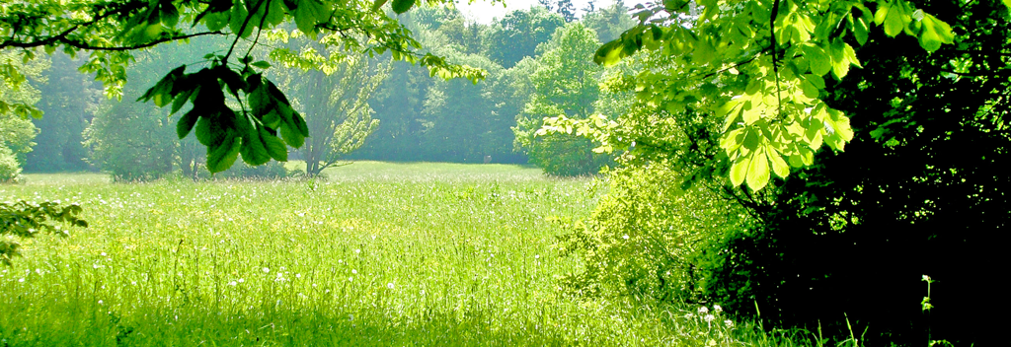
1. Economic values vs. moral values
Nature is special, invaluable, not for sale
Destruction of nature violates a deontological norm
Deontology = some things are just wrong (or right)
cf. utilitarianism = what matters is the welfare effect
£
£
£
£
£
$
€
$
$
$
$
€
£
Notes:
(1) There are intangible values of the natural environment that go beyond economics.
You can't compensate for the loss of a forest with a crate of smartphones.
Non-economists — e.g. naturalists as depicted in lecture 2 — are prone to arguing with economists on these grounds. Economists sometimes forget that utilitarianism isn’t the only moral philosophy, or even a pre-eminent one.

Slide 71
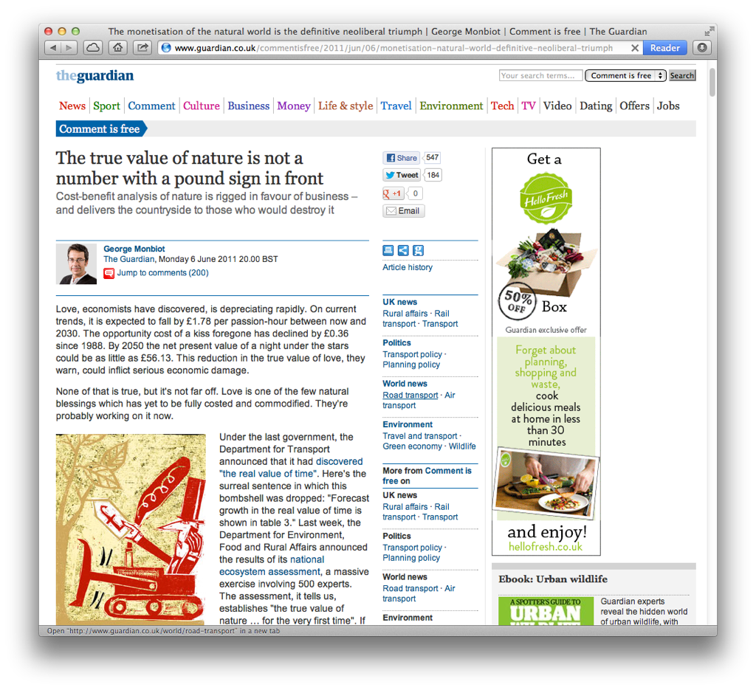
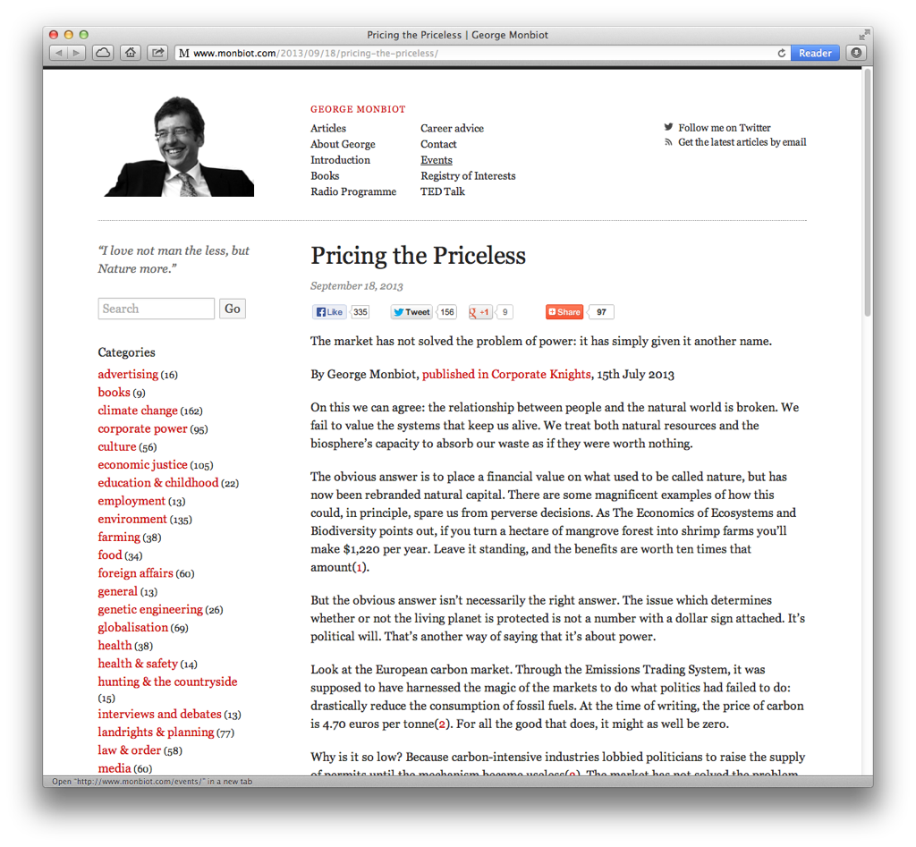
Notes:
George Monbiot is a particularly vocal champion of this perspective, and lays into environmental valuation about once a year or so in his column in the Guardian.
Video of a talk by Monbiot on SyD.
I have some sympathy with his view.

Slide 72
“The question I ask is: do the gains from using £X instead of the economist’s previous ‘zero’ outweigh the losses from using £X instead of the ecologist’s previous ‘infinity’?”
— Herendeen, 1998
0
∞
Notes:
However, a pragmatic way to look at it is to notice that economists tend to have a much greater say in policy than ecologists.
So if you decide not to value the environment, there’s a real danger that the environmental aspects of a project get given a zero value in a cost-benefit analysis.
There’s very little chance of them being given the near-infinite value that ecologists might prefer.
So the question is: …
And the answer is, in general, almost certainly yes.

Slide 73


2. It’s anthropocentric
Interests (and lives) of non-humans only counted via human preferences
Pandas 1 – 0 Cockroaches
Notes:
(2)
…
This is essentially a philosophical objection along similar lines to the previous one. Again naturalists arguing against utilitarians.
One result of this is that valuation makes it relatively easy to save charismatic species like pandas and tigers, but relatively rather hard to preserve uncharismatic ones like cockroaches or naked mole rats.
While you might argue they both have the same moral right to a peaceful existence.

Slide 74
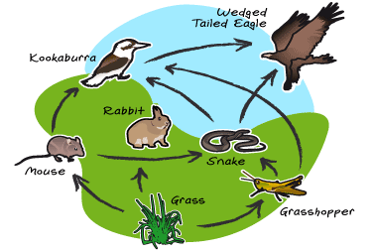
3. It misses connections
All parts of a natural ecosystem are mutually interrelated
Valuing one element (e.g. an animal species) on its own misses its contribution to the health of the whole
Notes:
(3)
We talked a bit about this in lecture 2 as well. This is more an objection raised by ecologists.
Food web, pictured.
May also recall the video Pauls shared — how wolves change rivers.

Slide 75
4. There’s too much uncertainty
We can’t value what we can’t predict
Potential irreversible loss of irreplaceable goods
e.g. liveable climate, biodiversity
?
Notes:
(4)
…

Slide 76
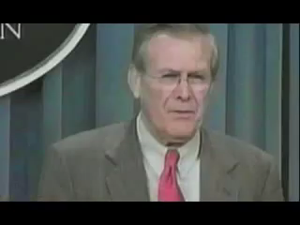
Notes:
We talked last week about using EV in the presence of risk — multiplying p by outcome — and also about taking society’s risk appetite into account by doing something more subtle.
But for some things, we have no probabilities. Sometimes we know a thing is possible but we just don’t know how likely it is. Other times, there are things that are completely off our radar.
Rumsfeld’s famous ‘unknown unknowns’ … (more next term in Beh Econ).
How big a problem?
Kinda depends on what we're talking about. Looks different if it's a local project vs global CO2 emissions.

Slide 77
5. It’s anti-democratic
WTP is bounded by what you can afford
One £, one vote
Disenfranchises the poor — and poor regions
Notes:
(5)
It is.
On the other hand, it also measures strength of preference, which can be valuable.
(Say 52% of people wanted something but they didn’t want it all that much, and 48% of people didn’t want it, with the passion of a thousand suns. Valuation might give a more reasonable reflection of that situation than a simple binary referendum).

Slide 78
DATE: December 12, 1991
TO: Distribution
FROM: Lawrence H. Summers
Subject: GEP
'Dirty' Industries: Just between you and me, shouldn't the World Bank be encouraging MORE migration of the dirty industries to the LDCs [Least Developed Countries]? I can think of three reasons:
1) The measurements of the costs of health impairing pollution depends on the foregone earnings from increased morbidity and mortality. From this point of view a given amount of health impairing pollution should be done in the country with the lowest cost, which will be the country with the lowest wages. I think the economic logic behind dumping a load of toxic waste in the lowest wage country is impeccable and we should face up to that.
2) The costs of pollution are likely to be non-linear as the initial increments of pollution probably have very low cost. I've always thought that under-populated countries in Africa are vastly UNDER-polluted ...
Notes:
In terms of equal treatment of the poor …
The infamous Summers memo — re. trade liberalization, signed by Lawrence Summers who was then Chief Economist of the World Bank.
Both Summers and Pritchett (who wrote it) say this was sarcastic … whether or not that’s true, it’s really just the standard economic logic applied and written out rather more clearly than usual.

Slide 79
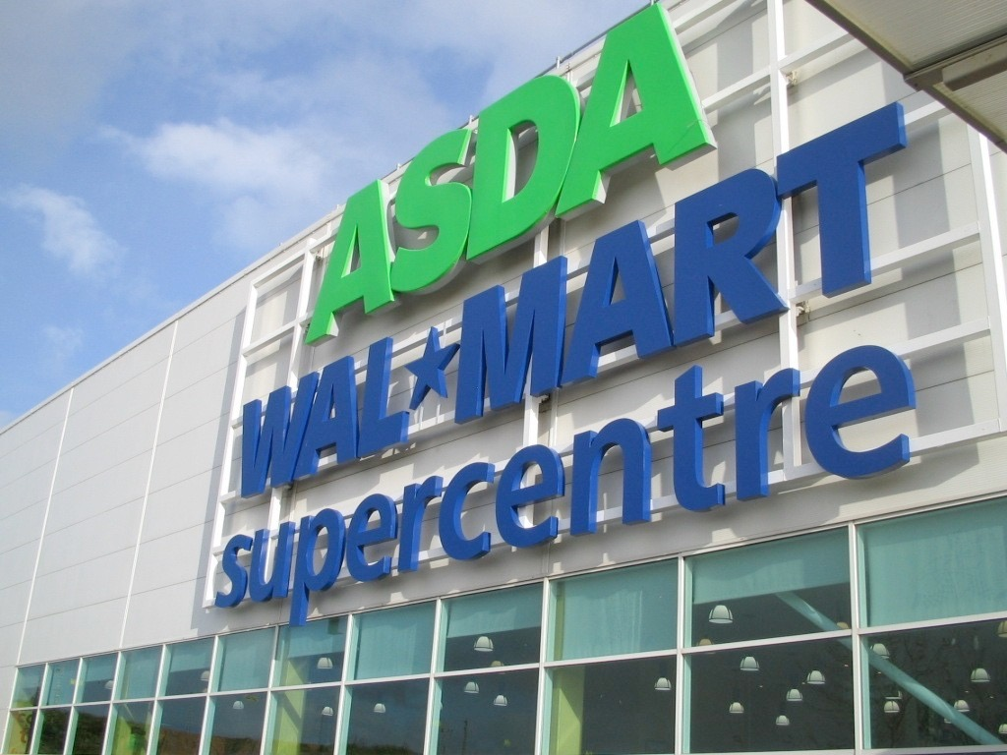
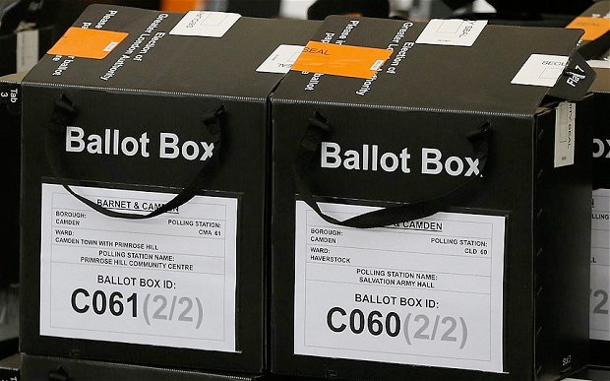
6. Consumer values vs. citizen values
Is your decision-making informed by different thought processes at the supermarket than at the ballot box?
Consumers: materialistic, individualistic
Citizens: altruistic, community-minded
Valuation mistakenly engages consumer preferences in a citizen context
Notes:
(6)
…

Slide 80
7. Studies may be flawed — or rigged
Complex procedures make it easy to miscalculate or manipulate values
Notes:
(7)
— more detailed critiques in a paper on SyD from the journal Radical Statistics!

